Slide 1
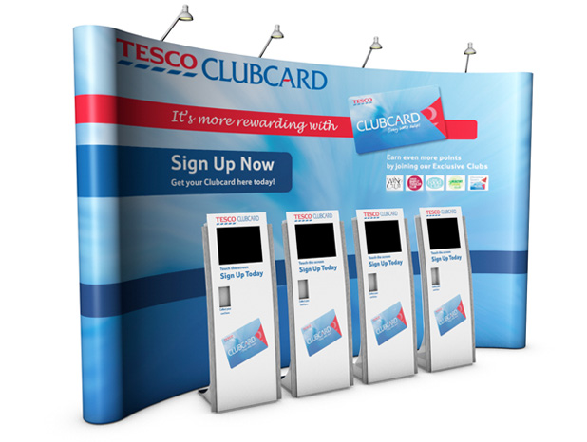
KIOSK

Slide 2
Contents
What is Kiosk
Description
Business Objective
High Level Functionality
Architecture/Application
Technical Details
How it is integrated with other systems
Application link and user details
Appendix

Slide 3
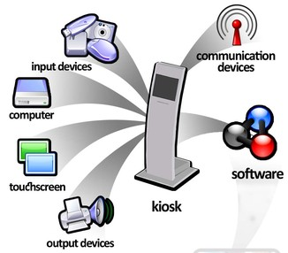
What is Kiosk
Kiosk is a computer-like device deployed in a public venue to give people self-service access to products and services.
Kiosks are most often deployed in situations where a problem can be solved by giving people access to self-service tools.

Slide 4
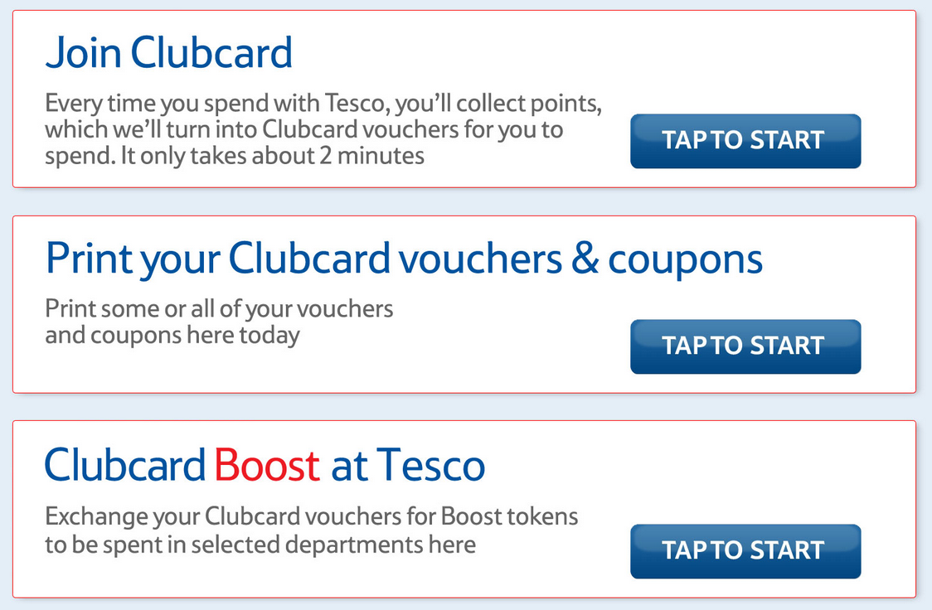
Description
Kiosk is an in-store self-service channel that provides Clubcard
customers with three functionalities:
Join Clubcard
Print your Clubcard Vouchers & Coupons
Clubcard Boost at Tesco

Slide 5
Description
Kiosk (an in-store self-service channel) at Tesco allows Clubcard customers to interact with the scheme in a new ways.
Clubcard Join on a touch screen kiosk allows a customer to signup to Clubcard, collecting all relevant customer details, and then issue them with a real Clubcard number and barcode immediately, on till receipt paper.

Slide 6
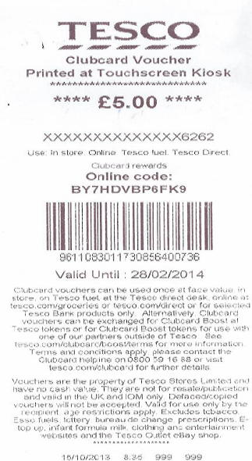
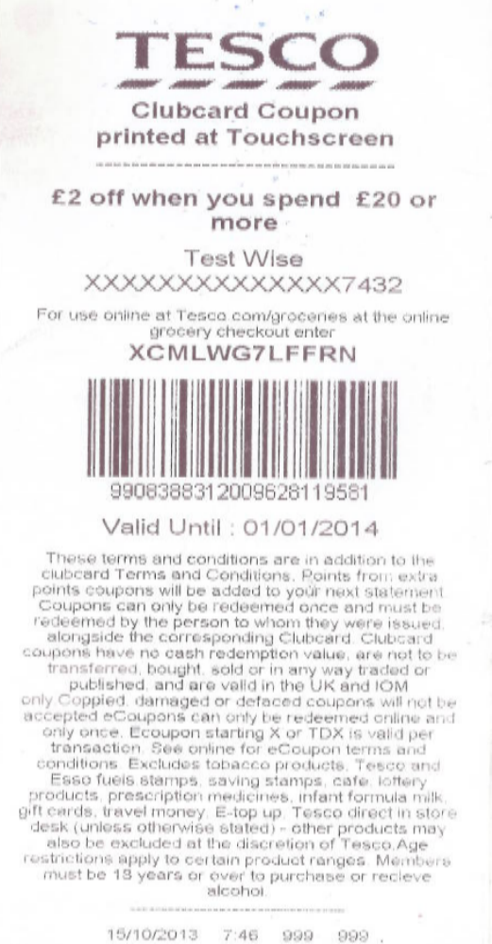
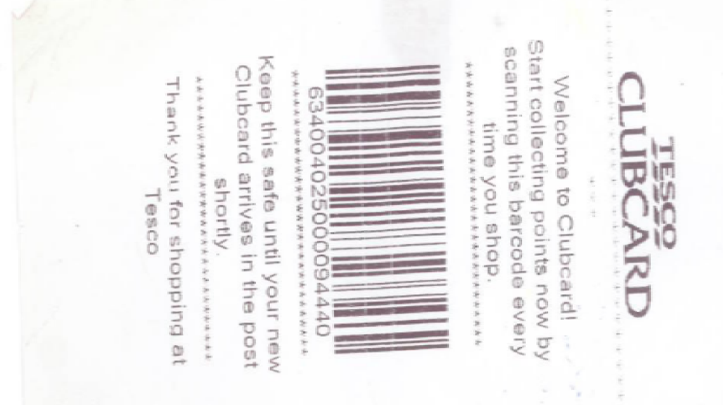
Join Clubcard Print Vouchers Print Coupons

Slide 7
Business Objective
The earlier BCVE process was carried out at the CSD, and
required input from staff at the desk. Allowing customers to carry
out their own voucher exchange will negate the need for this
investment in time at the CSD, and also allow customers to carry
out their exchange with less chance of a queue, at a dedication
touch screen kiosk. Customers need not carry coupons and
vouchers while going to the stores.
Clubcard Join will ease the customers to join Clubcard by filling the details on touch screen kiosk.
Clubcard Voucher Printout at Kiosk allows customers without access to a printer or internet access to print their vouchers in store.
Boost at Tesco allows customers to exchange their vouchers at a kiosk without having to queue at a customer service desk.

Slide 8
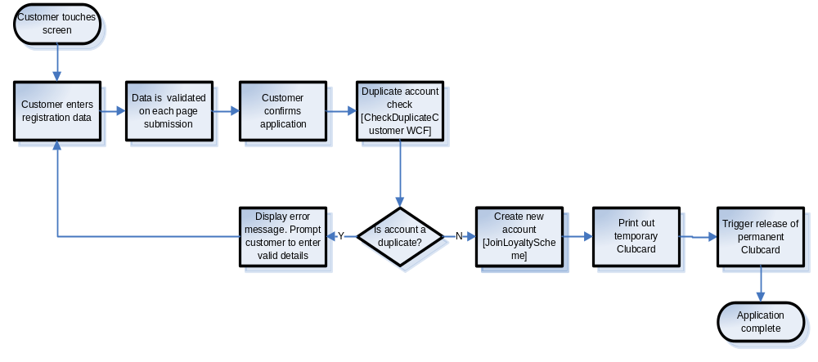
High-Level Functionality
Clubcard Join

Slide 9
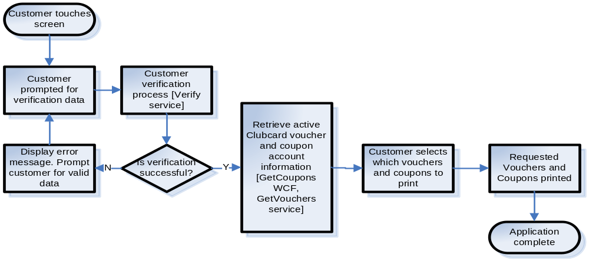
High-Level Functionality
Clubcard Voucher Printout at Kiosk

Slide 10
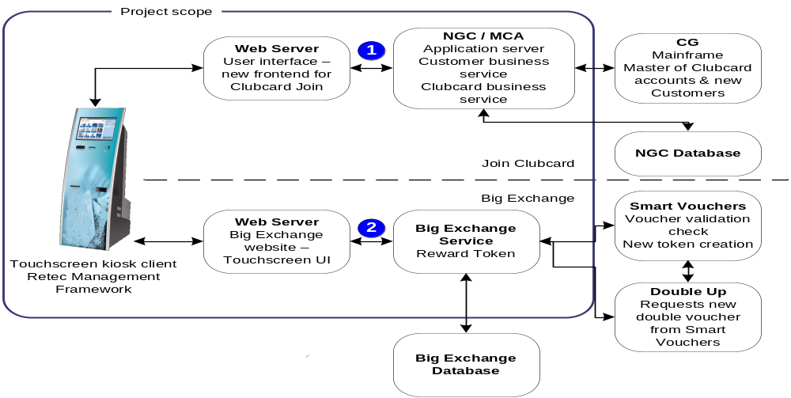
High-Level Functionality
Boost At Tesco

Slide 11
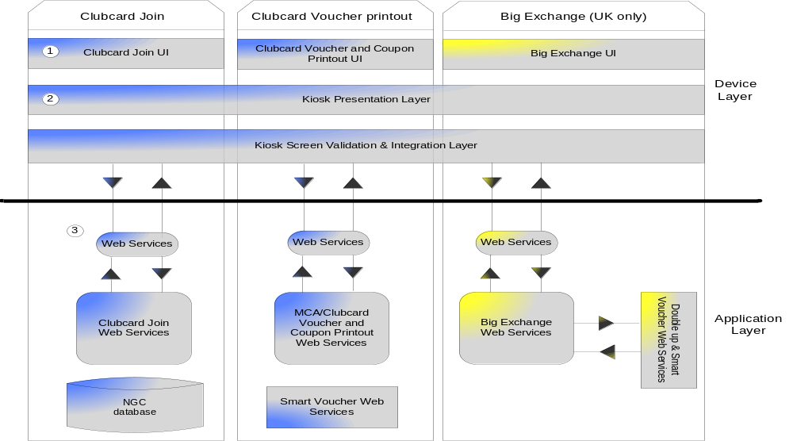
Application Architecture

Slide 12
Application Architecture
User Interface: Area 1 of the diagram depicts the user interface and presentation layer that needs to be developed for kiosks across both applications. The user interface will be developed so it can be accessed from a standard web browser (IE9).
Presentation Layer: The presentation layer performs two key activities: store session data between web pages and perform validation of data that is entered on the screens. These activities will be performed using the ASP.NET code-behind model of development. This will allow for separation of the code that the user interface will be written in (XHTML) and the code that performs validation and session data storage activities (programming language to be decided).
WCF Web Services: The applications will use the WCF services developed for group repeatable

Slide 13
Technical Details
The platform is Windows 2003 Server Standard Edition with the latest Tesco approved service pack installed.Net framework 4.0, and Internet Explorer 6.0, asp.net with C# as code behind to develop front end, WCF Services with C# as code behind to develop the server side Business logic, and the RDBMS is SQL server.

Slide 14
Integration with other systems
Kiosk
Join Clubcard
Print Coupons & Vouchers
Boost Exchange
Locator
Services
NGC
Services
Clubcard
Coupons
Services
Smart
Voucher
Services
Print
C&V
Services
Big
Exchange
Services
Dundee
dB
NGC
dB
Clubcard
dB
Smart
Vouchers
dB
Print
C&V
dB
Big
Exchange
dB

Slide 15
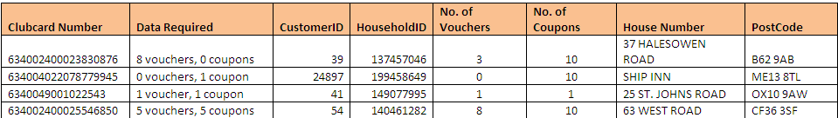

Application Link
http://172.21.211.232/KioskMenu/default.html
Test Accounts for Print Coupons & Vouchers
Test Accounts for Boost at Tesco

Slide 16
Appendix
Know more about Kiosk at Tesco
Kiosk Pre2011 Development
Kiosk 2011-2012 Development
Kiosk 2012-2013 Development

